Slide 1
3x3 Pattern Recognition using Rate Coding
Komatsu Yamato
S1300053@u-aizu.ac.jp
15 April 2025
Notes:
Keep this slide clean
Do not add line number here

Slide 2
Content (please edit as you want)
Research Introduction
Overall system/architecture
Research progress
Done
Doing
Todo
Schedule
Notes:
The content should be bief

Slide 3
Content
Research Introduction
Overall system/architecture
Research progress
Done
Doing
Todo
Schedule
Notes:
Before jumping to a new section, add a new slide:
Hide the other sections
Highlight the current section

Slide 4
Research introduction
My research focuses on Rate CodingRate Coding
I am implementing rate coding to convert binary image patterns into spike trains.
Platform: Raspberry Pi Pico using MicroPython

Slide 5
Content
Research Introduction
Overall system/architecture
Research progress
Done
Doing
Todo
Schedule
Notes:
Before jumping to a new section, add a new slide:
Hide the other sections
Highlight the current section

Slide 6
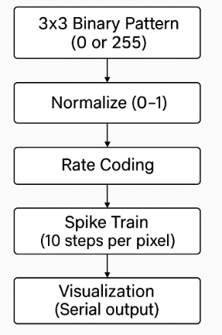
Overall system
- Pixel values are normalized and converted to probabilistic spikes.
- Each spike is shown as '█' (firing) or ' ' (silent) in a 3x3 matrix.

Slide 7
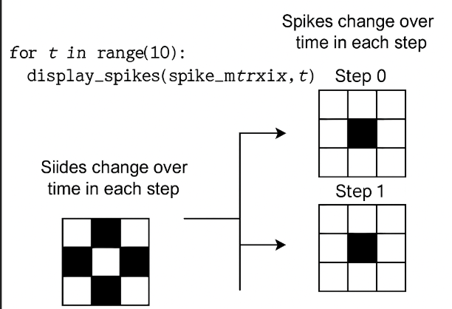
Overall architecture
This loop displays the temporal changes in spike activity over 10 time steps, one step at a time.
t represents the time step (from 0 to 9).
At each step, it visualizes which pixels in the 3×3 pattern are firing (spiking).
The output is shown using print() on a serial monitor or similar interface.

Slide 8
Overall architecture
Pixel Value | Normalized | Spike Probability | Example Display
255 | 1.0 | High (almost always fires) | "█"
0 | 0.0 | Low (almost never fires) | " " (blank)

Slide 9
Content
Research Introduction
Overall system/architecture
Research progress
Done
Doing
Todo
Schedule
Notes:
Before jumping to a new section, add a new slide:
Hide the other sections
Highlight the current section

Slide 10
Research Progress | Completed
Studied rate coding concept
Verified time-based spike visualization in serial monitor
Pattern: X-shape image (3x3, with 0/255)
Notes:
Briefly talk about what you have done
If possible. Highlight it in the overall architecture/system figure

Slide 11
Research Progress | On-going
Work on tutorial on STDP learning

Slide 12
Reserch Progress|To do
Implement STDP to the network and update weights(visualize weight before and after training)

Slide 13
Content
Research Introduction
Overall system/architecture
Research progress
Done
Doing
Todo
Schedule
Notes:
Before jumping to a new section, add a new slide:
Hide the other sections
Highlight the current section

Slide 14
Schedule (freestyle, please edit as you want)
Please update time
Time | April 2025 | May 2025 | … | Jan 2026
Task 1
Task 2
Task 1:Work on tutorial on STDP learning
Task 2: Implement STDP to the network and update weights

Slide 15
Thank you for your attention!
Notes:
Always end with a thank you slide
_ Ask if there is any question

